Slide 1
A Manifold Learning Method: t-SNE

Slide 2
Outline
Definition
Algorithms
Motivation
SNE
t-SNE
Effect

Slide 3
Definition
Manifold : A topological space that locally resembles Euclidean space near a point

Slide 5
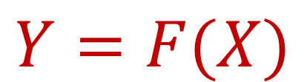
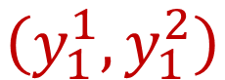
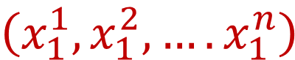
Manifold Learning
Y (R²)
X (R^{n})
$$\left(x_{1}^{1},x_{1}^{2},….x_{1}^{n}\right)$$
F
$$\left(y_{1}^{1},y_{1}^{2}\right)$$
$$Y=F(X)$$

Slide 6
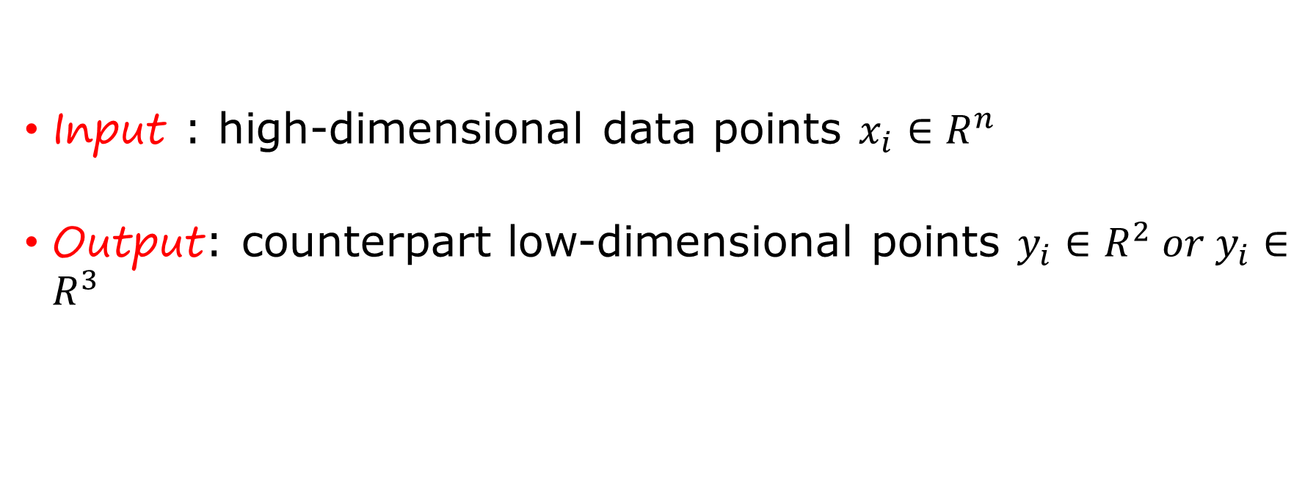
Problem Description
Input : high-dimensional data points $x_{i}∈R^{n}$
Output: counterpart low-dimensional points $y_{i}∈R^{2} or{ y}_{i}∈R^{3}$

Slide 7
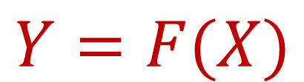
Algorithms
$$Y=F(X)$$
Principal Component Analysis(PCA)
Linear Discriminant Analysis(LDA)
Isomap
LoLaplaciancally Linear Embedding(LLE)
Eigenmaps
Hessian Eigenmaps
Local Tangent space alignment (LTSA)
Maximum variance unfolding (MVU)
Linear
Non-Linear
t-SNE

Slide 8
Motivation
Find meaningful low-dimensional structures hidden in high-dimensional space
Difficult to visualize data in dimensions greater than three
The visualizations produced by t-SNE are significantly better than those produced by the other techniques on almost all of the datasets --- Geoffrey Hinton

Slide 9
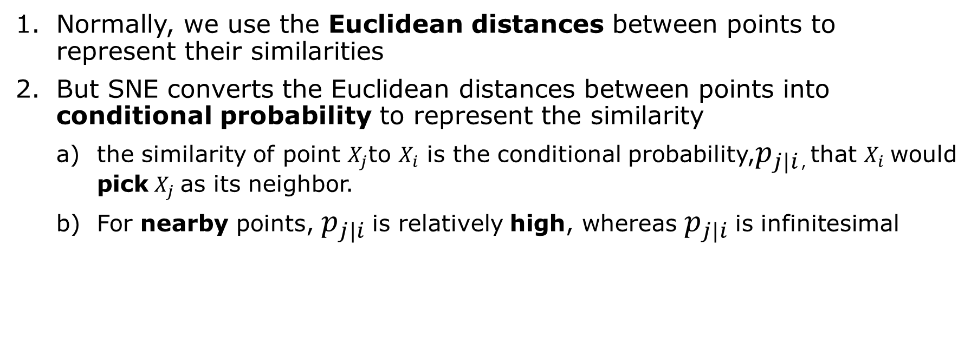
SNE
Normally, we use the Euclidean distances between points to represent their similarities
But SNE converts the Euclidean distances between points into conditional probability to represent the similarity
the similarity of point $X_{j}$to $X_{i}$ is the conditional probability,$p_{j|i}$, that $X_{i}$ would pick $X_{j}$ as its neighbor.
For nearby points, $p_{j|i}$ is relatively high, whereas $p_{j|i}$ is infinitesimal

Slide 10
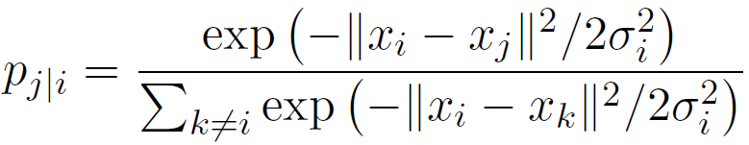
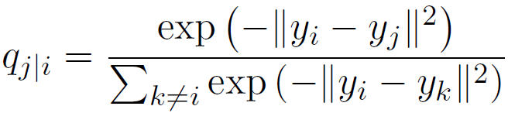
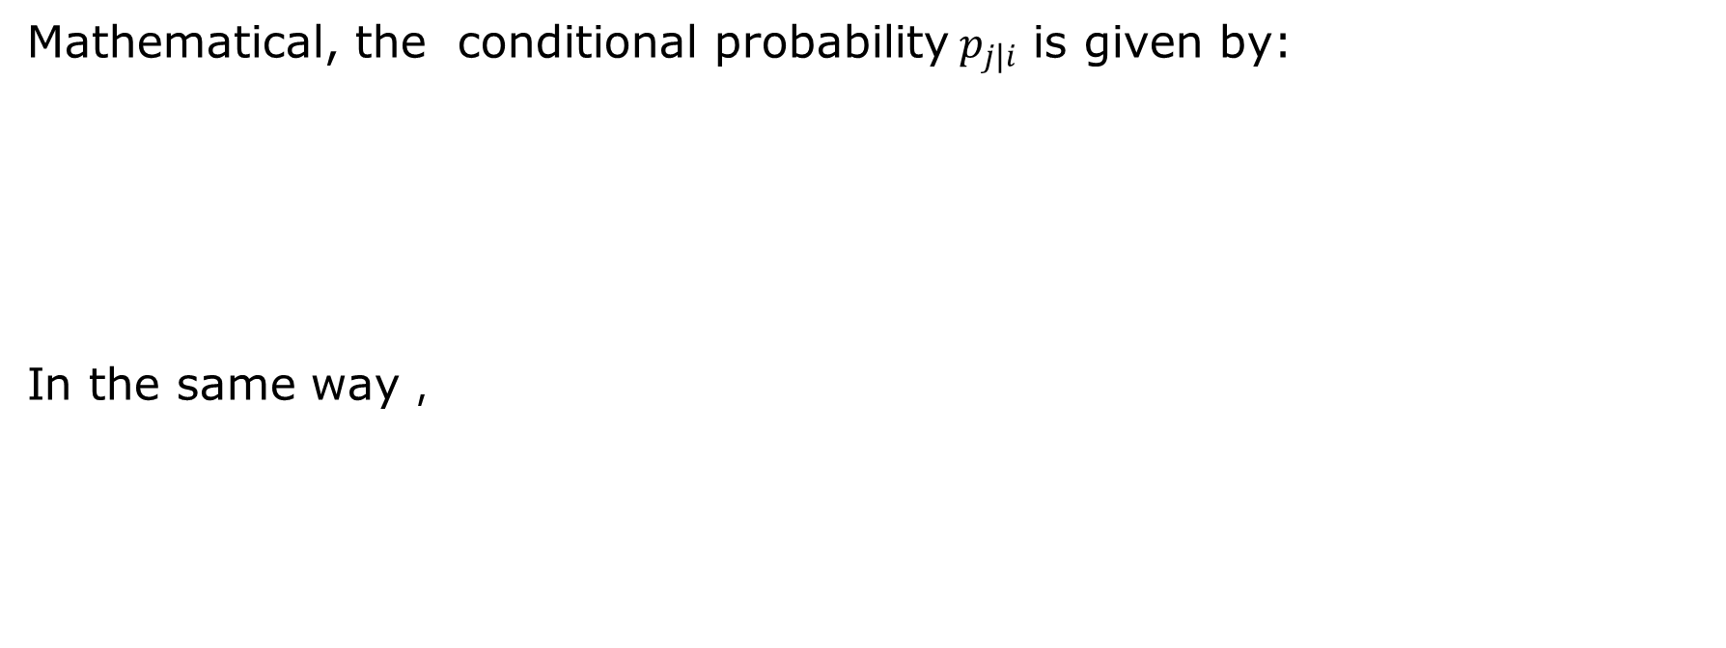
Mathematical, the conditional probability${ p}_{j|i}$ is given by:
In the same way，

Slide 11
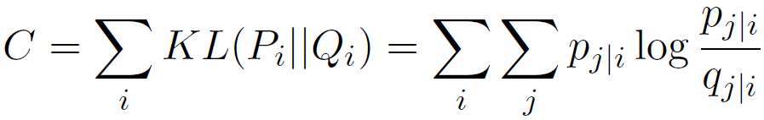
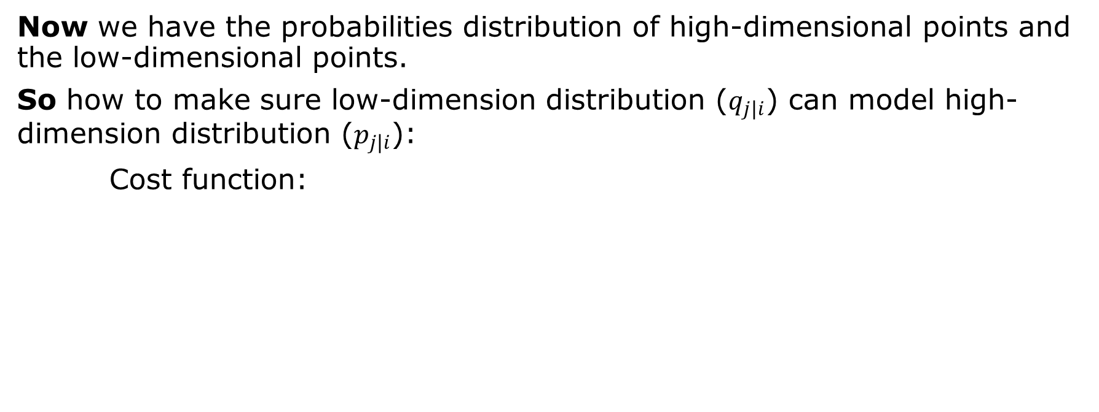
Now we have the probabilities distribution of high-dimensional points and the low-dimensional points.
So how to make sure low-dimension distribution ($q_{j|i}$) can model high-dimension distribution ($p_{j|i}$):
Cost function:

Slide 12
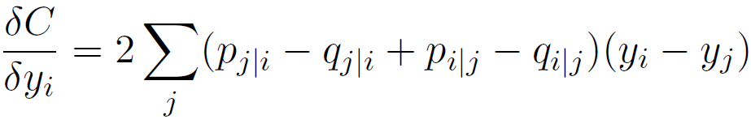
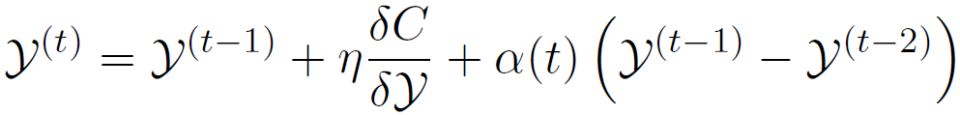

$$σ_{i}？$$

Slide 13
Issues with SNE
The cost function concentrates on more about the local structure, ignores the global structure (crowding problem).

Slide 14
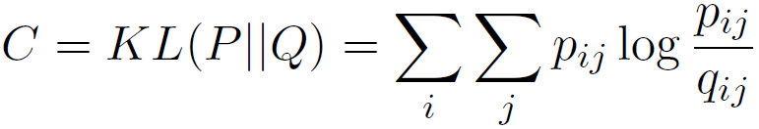
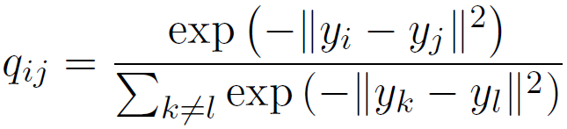
t-SNE
Symmetric SNE

Slide 15
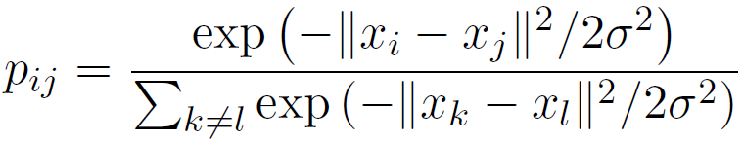
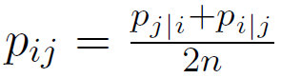
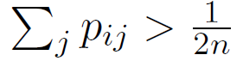
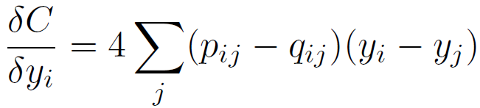

Slide 16
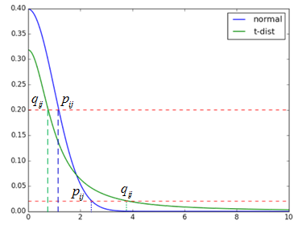
Crowding problem

Slide 17
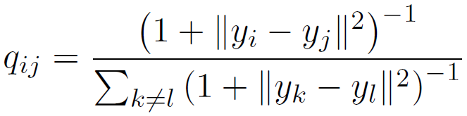
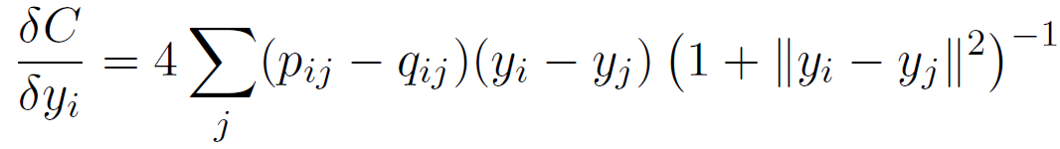
Crowding problem

Slide 18
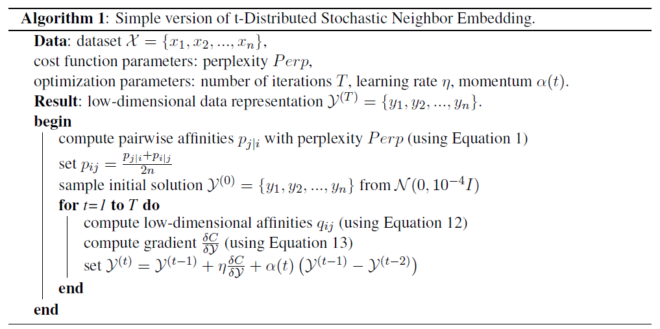
t-SNE Algorithm

Slide 19
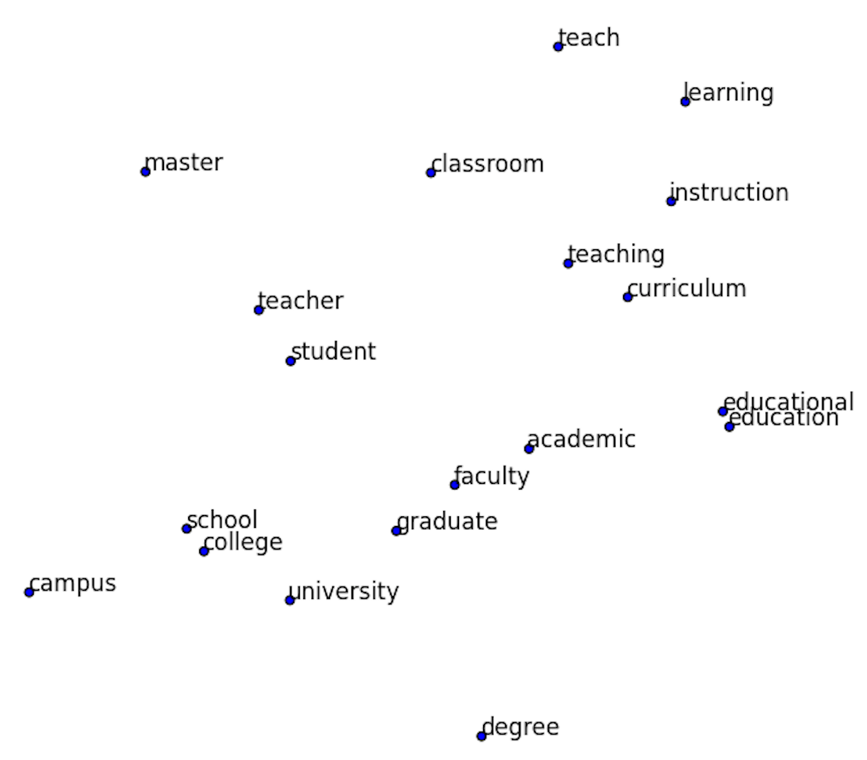
Effect

Slide 21


Slide 22
Thanks for your attention!

